Slide 1
SISTEMAS OPERATIVOS
SO
E – M 2019

Slide 2
Memory Management
Virtual Memory
Windows NT

Slide 3
Why Virtual Memory?
Program needs to be in memory to execute
Main, user routines, data structures, system routines
What’s going on if only few processes can be in memory, because some of them are huge? CPU view _________ Users view _______
Entire program code not needed at same time
Consider ability to execute partially-loaded program
Program no longer constrained by limits of physical memory
Each program takes less memory while running -> more programs run at the same time
Increased CPU utilization and throughput with no increase in response time or turnaround time
Less I/O needed to load or swap programs into memory -> each user program runs faster

Slide 4
Virtual Memory
Virtual memory – separation of user logical memory from physical memory
Only part of the program needs to be in memory for execution
More programs running concurrently
Less I/O needed to load or swap processes
Logical address space can therefore be much larger than physical address space (next slide)
Allows for more efficient process creation; how?
Allows physical address spaces to be shared by several processes ; how?

Slide 5
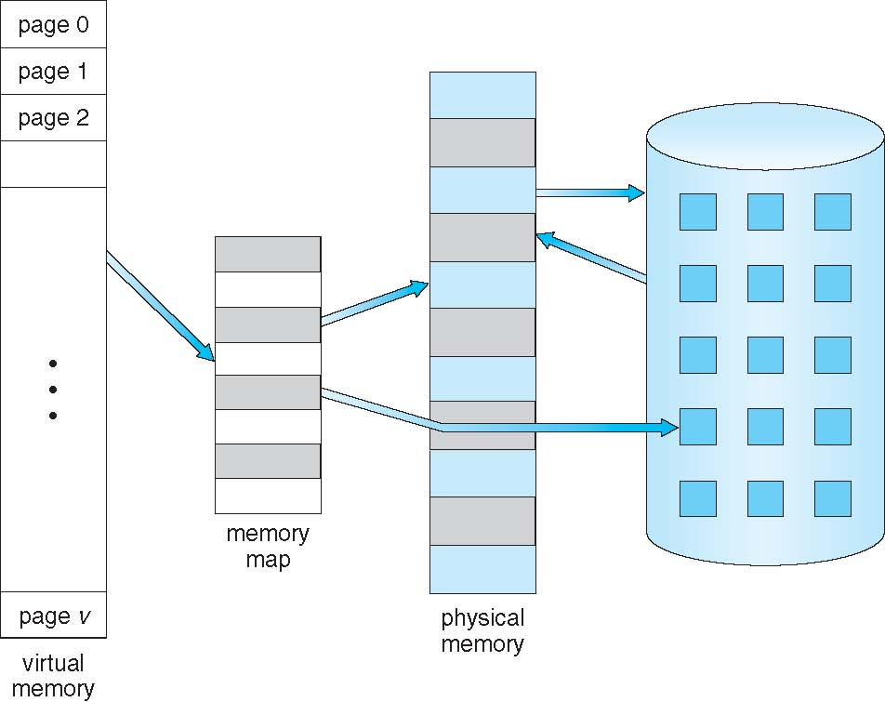
Virtual Memory larger than Physical Memory

Slide 6
Virtual address space - 1
Virtual / logical address space – logical view of how process is stored in memory
Usually start at address 0, contiguous addresses until end of space
Meanwhile, physical memory organized in page frames
MMU must map logical to physical

Slide 7
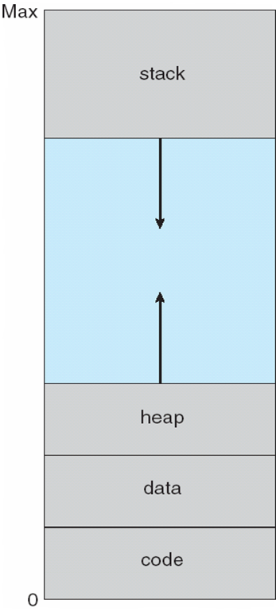
Virtual-address Space - 2
Usually design logical address space for stack to start at Max logical address and grow “down” while heap grows “up”
Maximizes address space use
Unused address space between the two is hole
No physical memory needed until heap or stack grows to a given new page
Enables sparse address spaces with holes left for growth, dynamically linked libraries, shared memory, etc.
System libraries shared via mapping into virtual address space
Shared memory by mapping pages read-write into virtual address space
Pages can be shared during vfork(), speeding process creation

Slide 8
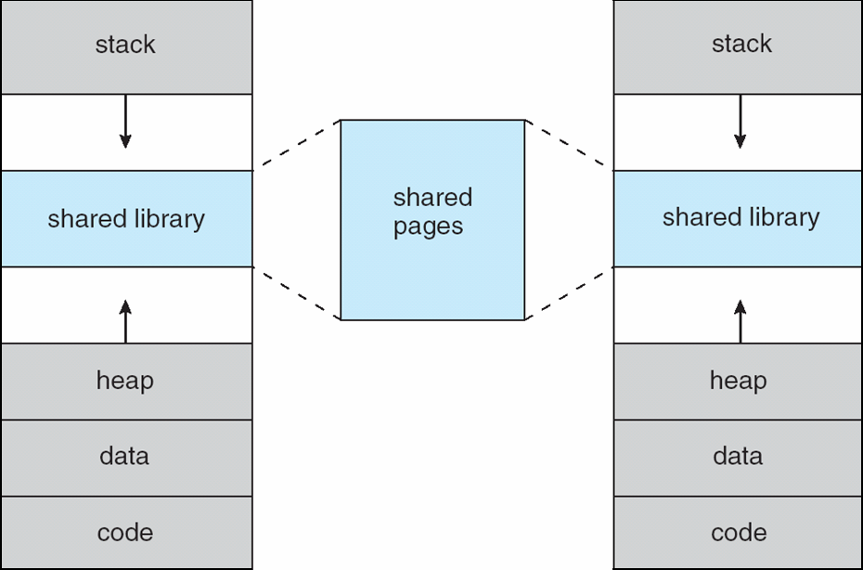
Shared Library with Virtual Memory

Slide 9
Loading processes
How an executable program might be loaded from disk into memory?:
Load the entire program in physical memory at execution time
But we may not initially need the entire program in memory
Techniques to load programs into a Virtual memory scheme:
Demand paging
Demand segmentation

Slide 10
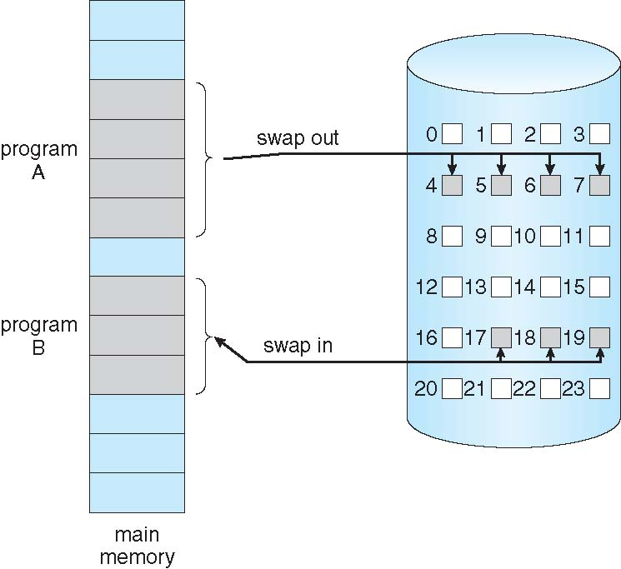
Demand Paging Scheme
Could bring entire process into memory at load time - Lazy swapper
Or bring a page into memory only when it is needed - pager
Less I/O needed, no unnecessary I/O
Less memory needed
Faster response
More users
Similar to paging system with swapping (diagram on right)
Page is needed ⇒ reference to it
invalid reference ⇒ abort
not-in-memory ⇒ bring to memory

Slide 11
Demand Paging. Basic Concepts
With swapping in, pager guesses which pages will be used before swapping out again, then pager brings in only those pages into memory
How to determine that set of pages?
Need new MMU functionality to implement demand paging
If pages needed are already memory resident
No difference from non demand-paging
If page needed and not memory resident
Need to detect and load the page into memory from storage
Without changing program behavior
Without programmer needing to change code

Slide 12
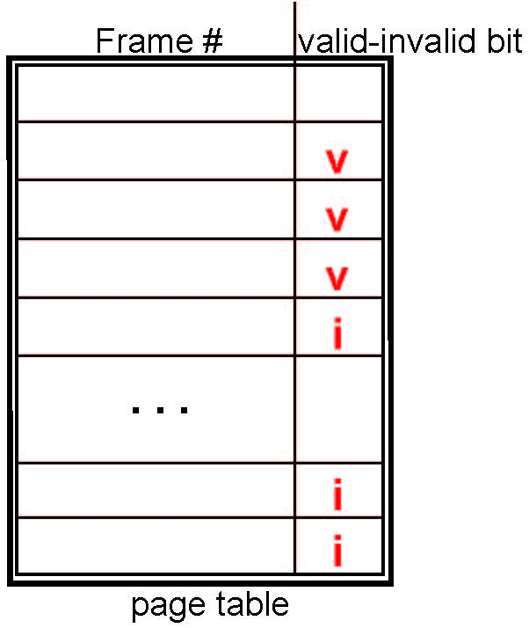
Valid-Invalid Bit
With each page table entry a valid–invalid bit is associated (v ⇒ in-memory – memory resident, i ⇒ not-in-memory)
Initially valid–invalid bit is set to i on all entries
Example of a page table snapshot:

Slide 13
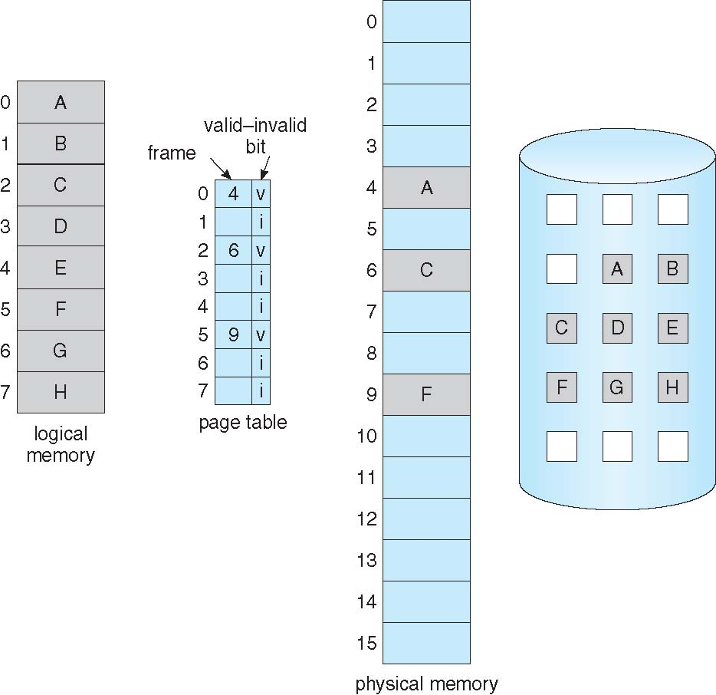
Page Table: some pages are not in Main Memory

Slide 14
Page Fault
If during MMU address mapping, there is a reference to a page with valid–invalid bit in i, in page table entry, ⇒ cause a trap to operating system page fault
Operating system looks at another table (of PCBs) to decide:
Invalid reference ⇒ abort
Just not in memory, just in the swap area
Find free frame
Swap page into frame via scheduled disk operation
Reset tables to indicate page now in memory Set validation bit = v
Restart the instruction that caused the page fault

Slide 15
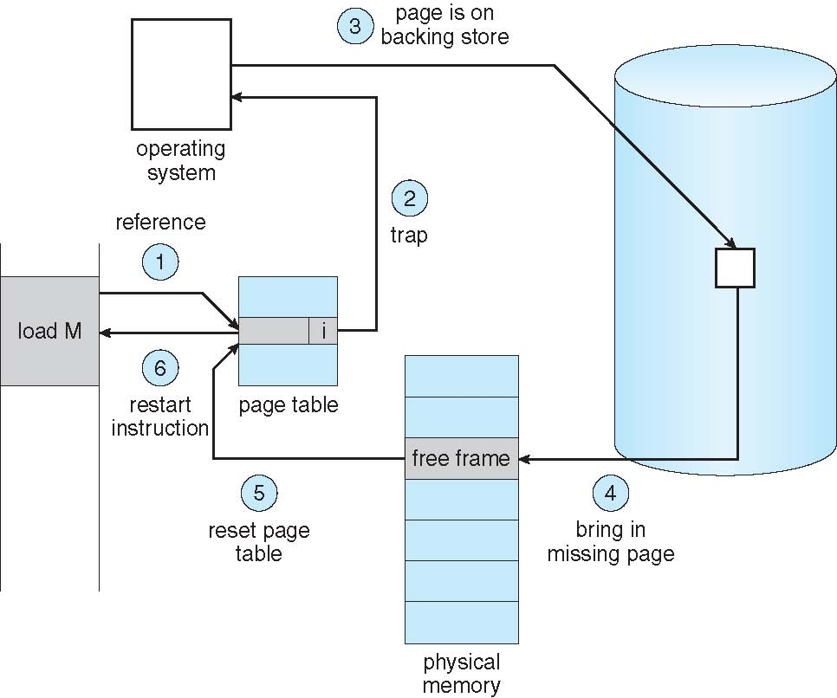
Steps in Handling a Page Fault

Slide 16
What Happens if There is no Free Frame?
Used up by process pages
Also in demand from the kernel, I/O buffers, etc
How much to allocate to each?
Page replacement – find some page in memory, but not really in use, page it out (swap out)
Algorithm – terminate? swap out? replace the page?
Performance – want an algorithm which will result in minimum number of page faults
Same page may be brought into memory several times

Slide 17
References
Presentación de Ramon Ríos.
Capítulos: Operating System Concepts; Silberschatz, Galvin, Gagne.
16-may-2019

